Slide 1

Hello Students!
Welcome to
Basic Electronics
class!

Slide 2
Course Name : Basic Electronics
Session : 2022-2023
Course Code : EC22001
Semester/Batch : 1st/2022
L-T-P (Per Week) : 4-0-2
Course Credits : 5

Slide 3
Scope & Objectives of the Course:
To comprehend the principles of basic electronics for engineering undergraduates.
To understand the characteristics of semiconductor devices such as diodes, transistors and operation of circuits such as rectifier, voltage regulator and amplifiers.
To implement simple Boolean expressions using logic gates.

Slide 4
The main objectives of the course are:
Understand the basic concepts of semiconductor diodes and transistors and their applications in electronic circuits.
Differentiate between V-I characteristics of forward and reverse biased PN junctions and their implementation in engineering disciplines.
Understand the basic building block of digital electronics and its applications.

Slide 5
Course Learning Outcome:
CLO1: To understand the basics of electronics elements, their functionality and applications and to perceive the concept of analog and digital electronics.
CLO2: To analyse the characteristics of various types of diodes and transistors to describe the operation of related circuits for evolving engineering solutions.
CLO3: To apply fundamental principles of electronics together with analytic tools to evaluate and describe physical situations appropriate to address a scientific problem.
CLO4: To possess an ability to explore physical systems by setting up experiments, collecting and analyzing data, identifying sources of uncertainty, and interpreting their results in terms of the fundamental principles and concepts of electronics.

Slide 6
SYLLABUS
Unit-1: Semiconductor Diodes and Applications
Unit-2: Transistors and Applications
Unit 3: Number Systems and Logic Gates
Unit-4: Digital Circuits

Slide 7
Recommended Books
B1: Basic Electronics and Linear Circuits by N. N Bhargava, D.C Kulshreshtha, S. C Gupta; McGraw Hill Publications, Second Edition, 2013.
B2: Basic Electrical and Electronics Engineering by R. Muthusubramanian, S. Sahlivahanan McGraw Hill, First Edition, 2010.
B3: Basic Electronics by D. P. Kothari, I. J. Nagrath, McGraw Hill, Second Edition, 2014.
B4: Solid State Electronic Devices by D. K. Bhattacharya, Rajnish Sharma, Oxford University Press, Second Edition, 2013.
B5: Electronic Principles by Albert Malvino, David J. Bates, Mcgraw Hill Education, Seventh Edition, 2007.

Slide 8
Unit-1: Semiconductor Diodes and Applications
Introduction to Electronics, Familiarization with basic electronic components and measuring instruments.
Semiconductor Theory, Review of PN junction operation, Forward and Reverse V-I Characteristics of PN-Junction Diode.
Use of Diodes in Rectifiers, Half Wave, Full Wave-Centre-tap and Bridge Rectifier (Circuit diagram, Waveforms, RMS value, DC value and Peak value, PIV, Ripple Factor, Efficiency).
Zener diode and its application as Voltage Regulator,
Special Purpose Diodes: Light Emitting Diode (LED), Photodiode.

Slide 9
Introduction to Electronics,
Familiarization with basic electronic components and measuring instruments.

Slide 10
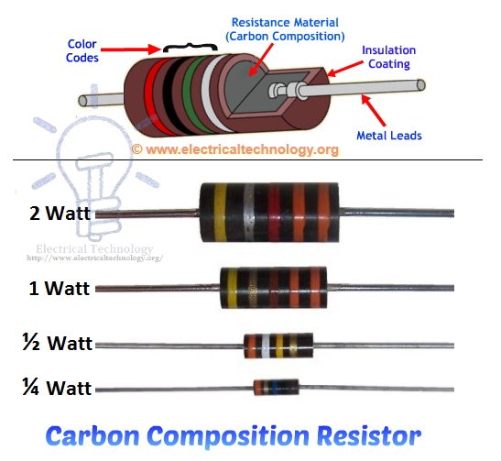
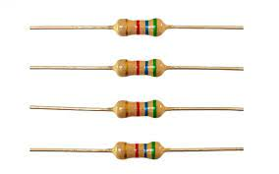
Resistor
A resistor is a passive two-terminal electrical component that implements electrical resistance as a circuit element.
Resistors reduce current flow and lower voltage levels within circuits.

Slide 11
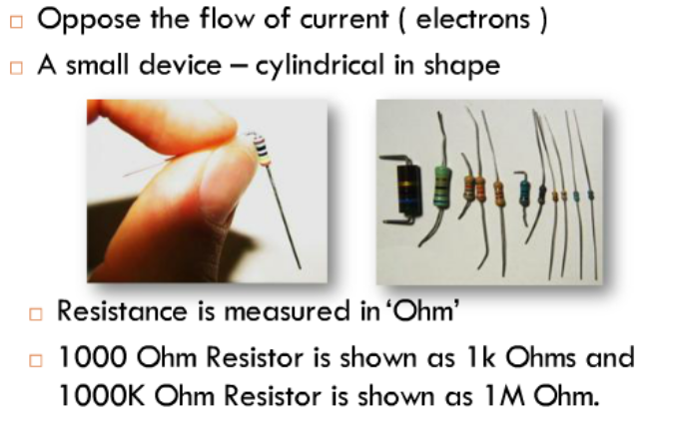

Slide 12
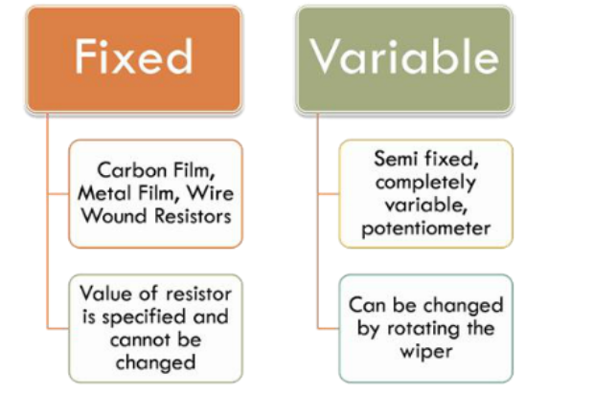
Types of Resistors

Slide 13
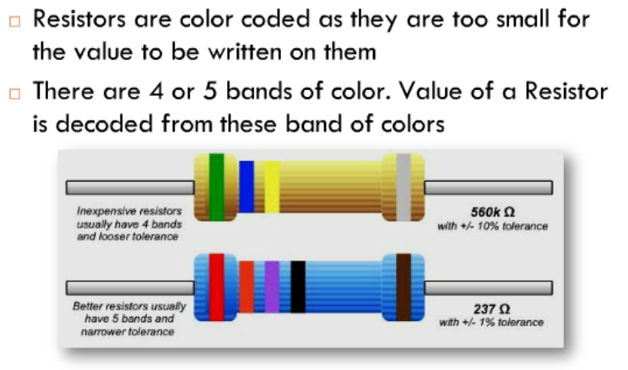
Reading value of Fixed Resistor

Slide 14
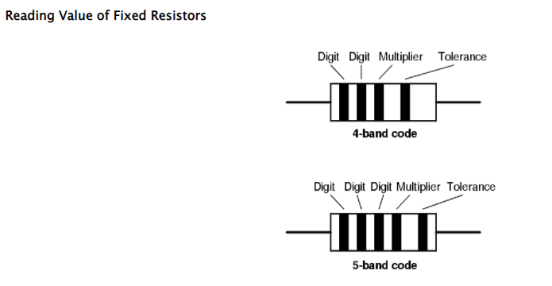
Reading value of Resistor

Slide 15
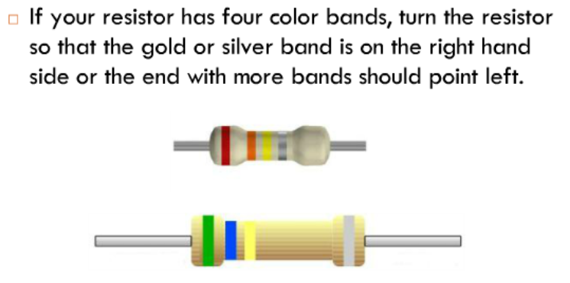
Reading Value:Step 1

Slide 16
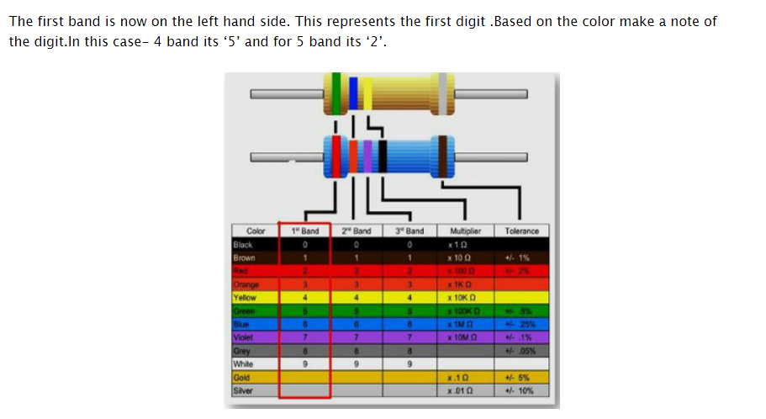
Reading Value:Step 2

Slide 17
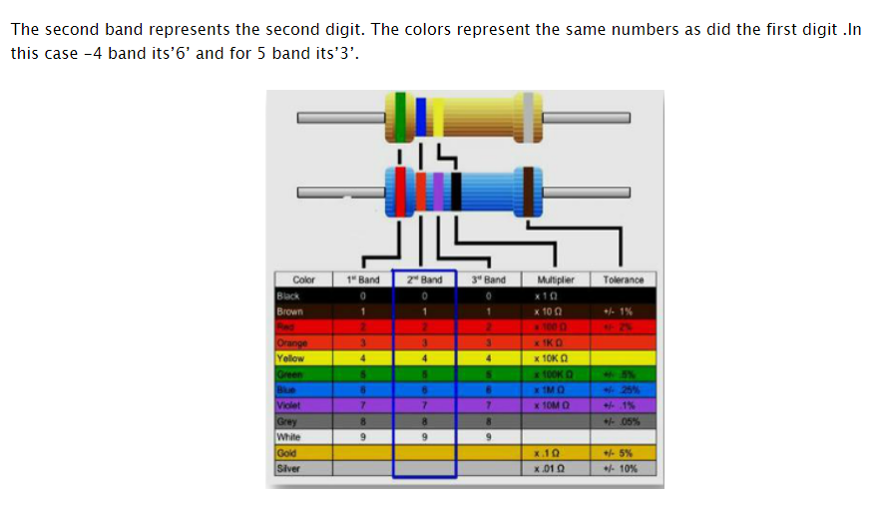
Reading Value :Step 3

Slide 18

Reading Value : Step 4

Slide 19
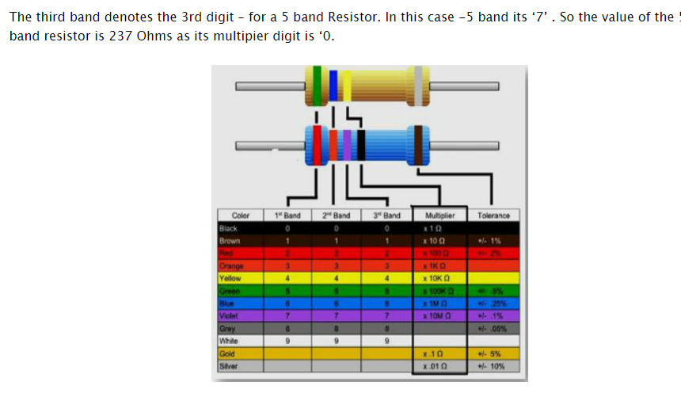
Reading Value : Step 5

Slide 20

Tolerance

Slide 21
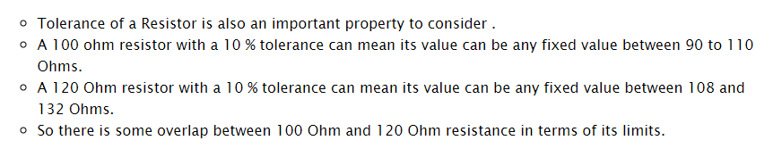
Tolerance

Slide 22
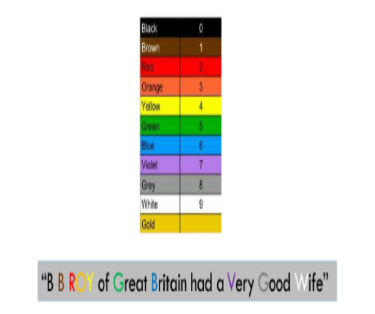
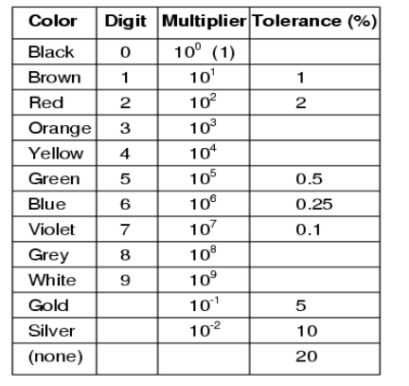
Mnemonic to Remember

Slide 23
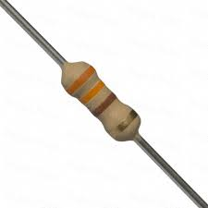
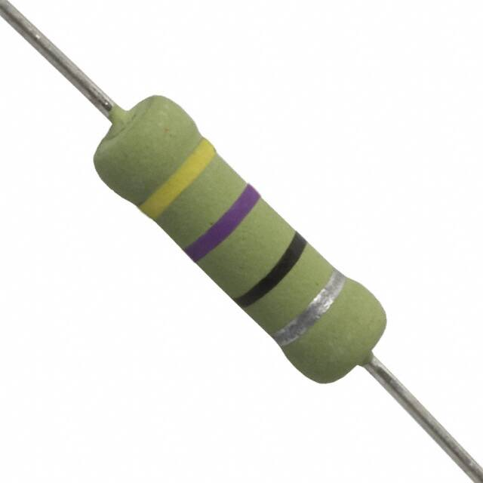
Find the color code for given resistors.

Slide 24
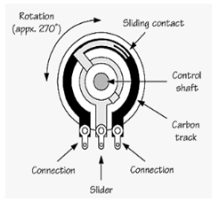
Variable Resistor
A variable resistor is a type of resistor whose electrical resistance value can be adjusted on demand. Variable resistors are used in an electronic circuit to adjust circuit resistance as a means to control the voltage or current within a circuit (as per Ohm’s Law).
The electrical resistance is varied by sliding a wiper contact along a resistance track. Sometimes the resistance is adjusted at preset value as required at the time of circuit building by adjusting screw attached to it and sometimes resistance can be adjusted as when required by controlling knob connected to it.

Slide 25
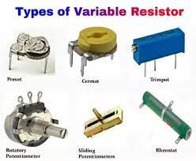
Variable Resistor

Slide 26
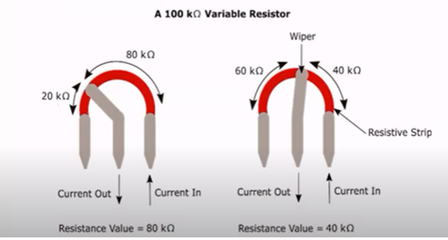
Variable Resistor

Slide 27
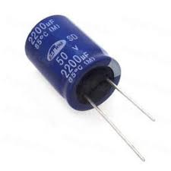
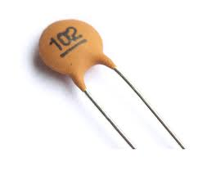
Capacitor
A capacitor is a passive two-terminal electrical component to store electric energy in an electric field. The most common kinds of capacitors are: • Ceramic capacitors have a ceramic dielectric • Film capacitors or plastic film capacitors are non-polarized capacitors with an insulating plastic film as the dielectric. • Electrolytic capacitors (e-caps) are polarized capacitors whose anode electrode (+) are made of a special metal on which an insulating oxide layer originates by anodization (forming), which acts as the dielectric of the electrolytic capacitor.

Slide 28
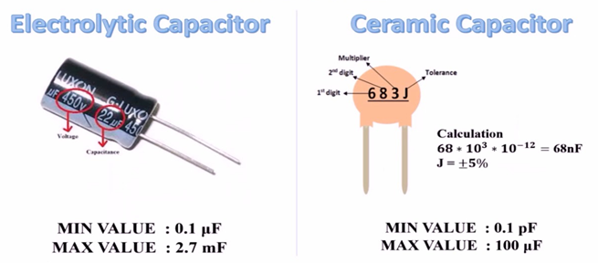
Types of Capacitor and how to read its value

Slide 29
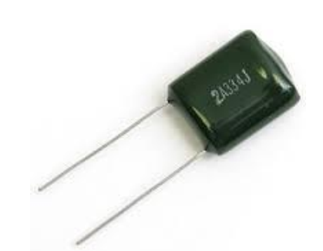
Polyester capacitor
Film capacitors or plastic film capacitors are non-polarized capacitors with an insulating plastic film as the dielectric. The plastic films used as the dielectric are Polypropylene (PP), Polytetrafluoroethylene or Teflon (PTFE).

Slide 30
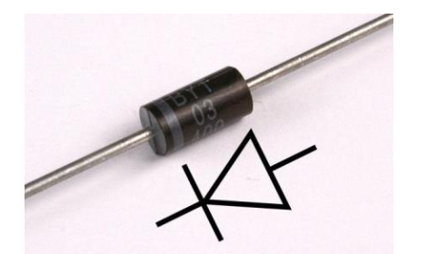
PN diode
A diode is a two-terminal electronic component that conducts primarily in one direction ; it has low (ideally zero) resistance to the flow of current in one direction, and high (ideally infinite) resistance in the other.

Slide 31
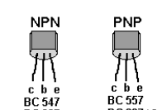
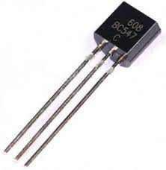
Transistor
It is a semiconductor device used to amplify or switch electronic signals and electrical power.

Slide 32
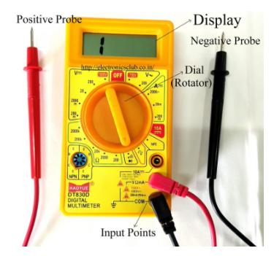
Multimeter
It is one of the most versatile general-purpose instruments capable of measuring dc and ac voltages as well as currents and resistances.

Slide 33
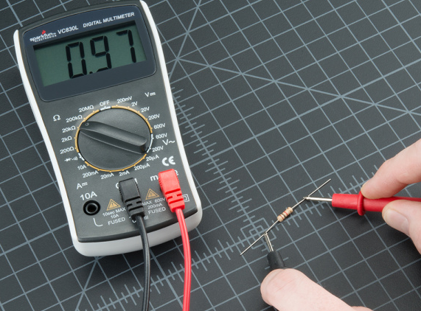
Measuring Resistance using Multimeter
1. Select the range of resistance.
2. Place the leads of the Multimeter across the terminal of the unknown resistance. Note down the values.

Slide 34
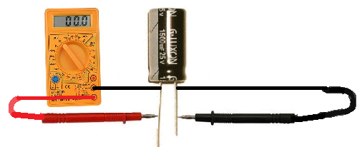
Measuring capacitance using Multimeter
Select capacitance option and place the leads of the multimeter across the terminal of the unknown capacitance. Note down the values.

Slide 35

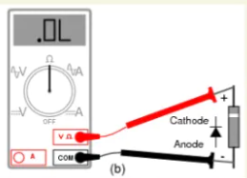
Checking Diode using Multimeter
Turn the dial (rotary switch) to Diode Test mode ( ).
Connect the test leads to the diode. Record the measurement displayed.
Reverse the test leads. Record the measurement displayed.
A good forward-based diode displays a voltage drop ranging from 0.5 to 0.8 volts for the most commonly used silicon diodes.
Some germanium diodes have a voltage drop ranging from 0.2 to 0.3 V.

Slide 36
Checking transistor using Multimeter
Hook the positive lead of the multimeter to the BASE (B) of the transistor.
Hook the negative lead to the EMITTER (E) of the transistor.
For a good NPN transistor, the meter should show a voltage drop between 0.45V and 0.9V.

Slide 37
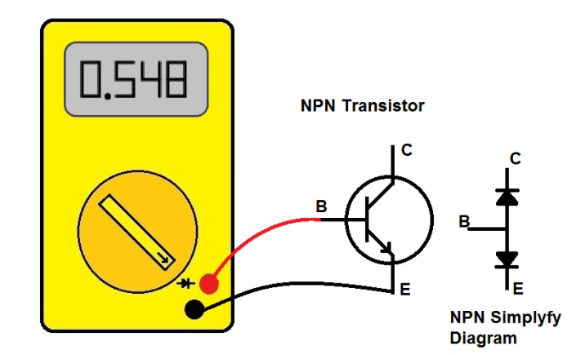
check NPN Transistor using Multimeter
First turn ON digital multimeter and select diode mode.
Connect the test leads to the transistor terminals.
Red probe to Base terminal and Black probe to Emitter terminal.
Read the measurement displayed.
If the transistor value is within the measurement range, the multimeter will display the transistor value.
displayed multimeter value is from 0 above 150, the transistor is good.
displayed multimeter value is 0 or .0L, the transistor is bad.

Slide 38
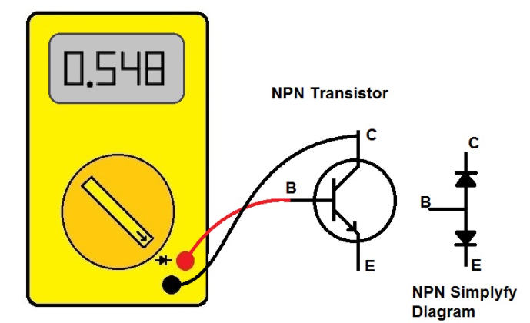
check NPN Transistor using Multimeter
Connect the test leads to the transistor terminals. Red probe to Base terminal and Black probe to Emitter terminal.
Read the measurement displayed. If the transistor value is within the measurement range, the multimeter will display the transistor value.
displayed multimeter value is from 0 above 150, the transistor is good.
displayed multimeter value is 0 or .0L, the transistor is bad.

Slide 39
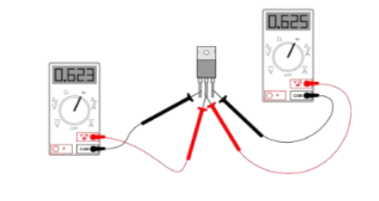
Checking transistor using Multimeter
If we kept the positive probe at the center leg of the transistor then it is an NPN transistor.
If we kept the negative probe at the center leg then we have a PNP transistor.
The center leg of the transistor is called Base.
When we exchange, the testing probes-
The leg with the lower reading of resistance is the Collector
The legs with the higher reading of resistance is the Emitter.

